Slide 1

CUSTOMER EXPERIENCE & SENTIMENT ANALYTICS STUDY A Pilot Customer Intelligence Analysis of Papaye Fast Foods Customer Reviews Branches Analyzed: Haatso Branch Tema Branch
Prepared by:
Richard Adutwum
MSc Marketing | AI Adoption Researcher | Business Analytics & Customer Insights Professional
June 2026
This analysis was conducted independently as a practical application of customer experience analytics and sentiment analysis techniques. As a former employee who greatly values the role Papaye played in my professional development, I wanted to explore how publicly available customer feedback could be transformed into actionable business insights.

Slide 2
EXECUTIVE SUMMARY
As part of my continued professional development in marketing analytics, customer experience management, and data analytics, I conducted an independent pilot study using publicly available customer reviews from the Haatso and Tema branches of Papaye Fast Foods.
The objective was to understand customer perceptions, identify satisfaction drivers, uncover recurring complaints, and demonstrate how customer feedback data can be transformed into actionable business insights.
A total of 134 customer reviews were analyzed using sentiment analysis and descriptive analytics techniques.
Key Findings
61.19% of reviews expressed positive sentiment.
Haatso outperformed Tema across all rating dimensions.
Food quality remains the strongest driver of customer satisfaction.
Waiting time and service speed represent the most common customer concerns.
Customer review analytics can provide valuable operational insights for management decision-making.

Slide 3
PROJECT OBJECTIVES
Objectives of the Analysis
This study aimed to:
Understand Customer Sentiment
Determine whether customers generally express positive, neutral, or negative experiences.
Compare Branch Performance
Evaluate differences between Haatso and Tema customer experiences.
Identify Customer Satisfaction Drivers
Determine which aspects of the customer experience contribute most strongly to positive reviews.
Identify Improvement Opportunities
Highlight recurring complaints and operational challenges affecting customer satisfaction.
Demonstrate Data-Driven Decision Making
Illustrate how customer feedback can support continuous business improvement.

Slide 4
DATASET OVERVIEW
Metric | Value
Total Reviews | 134
Branches Analyzed | 2
Positive Reviews | 82
Negative Reviews | 31
Neutral Reviews | 21
Important Note
This project represents a pilot study involving two branches and serves as a proof of concept for broader customer review analytics across the company's branch network.

Slide 5
ANALYTICAL APPROACH
Methodology
Customer Reviews
Data Preparation
Sentiment Analysis
Branch Performance Analysis
Business Recommendations
Customer reviews from the Haatso and Tema branches were collected, cleaned, analyzed using sentiment analysis techniques, and evaluated to identify customer satisfaction drivers and improvement opportunities.

Slide 6
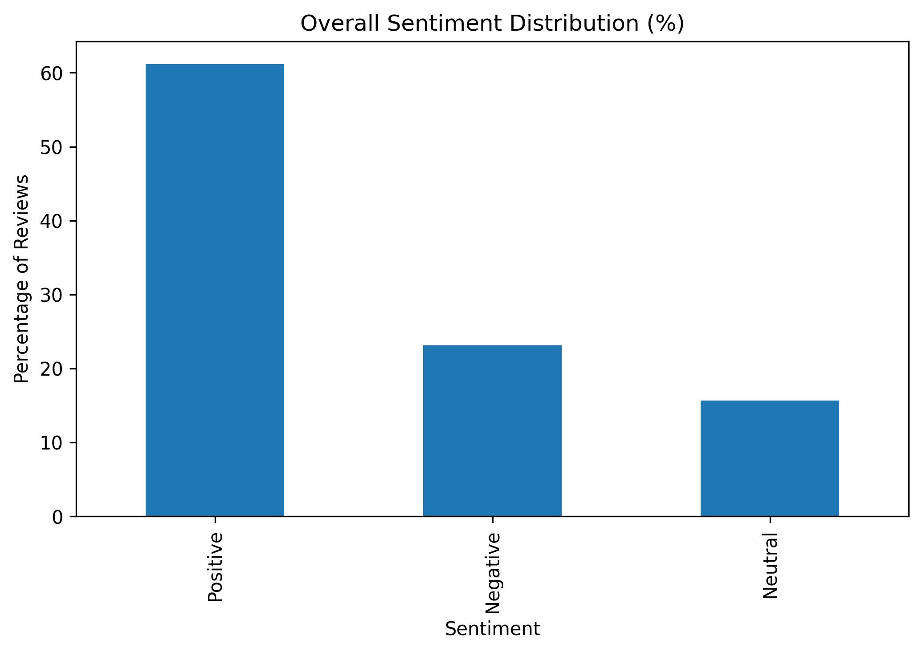
OVERALL CUSTOMER SENTIMENT
Key Findings
Positive Reviews: 61.19%
Neutral Reviews: 15.67%
Negative Reviews: 23.13%
Interpretation
The analysis revealed that customer sentiment toward Papaye Fast Foods is predominantly positive. More than six out of every ten reviews expressed favorable customer experiences, indicating generally strong customer satisfaction across the branches analyzed.
Business Implication
While the majority of customers reported positive experiences, the presence of negative reviews highlights opportunities to improve service consistency and operational efficiency.

Slide 7
BRANCH SENTIMENT COMPARISON
Key Insight
Both branches achieved predominantly positive customer sentiment. However, the Tema branch recorded a higher proportion of negative reviews (28.6%) compared to the Haatso branch (21.4%), suggesting greater customer dissatisfaction with certain aspects of the customer experience.
Business Implication
Reducing operational issues and improving service consistency at the Tema branch may help improve customer perception and reduce negative customer experiences.

Slide 8
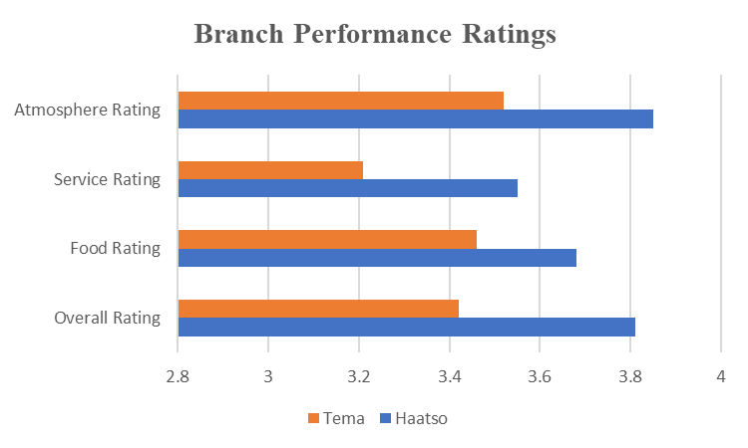
BRANCH PERFORMANCE RATINGS
Key Insight
Haatso consistently achieved higher customer ratings across all evaluated dimensions.The largest performance gap was observed in service quality, suggesting that operational execution may be contributing to lower customer satisfaction at the Tema branch.
Key Findings
Haatso recorded higher ratings across all four categories.
Atmosphere received the highest ratings at both branches.
Service quality received the lowest average ratings.
The rating results closely align with the sentiment analysis findings.
Business Implication
Improving service efficiency and customer interactions may represent the greatest opportunity for enhancing customer satisfaction, particularly at the Tema branch.
Ratings represent customer evaluations extracted from publicly available review data.

Slide 9
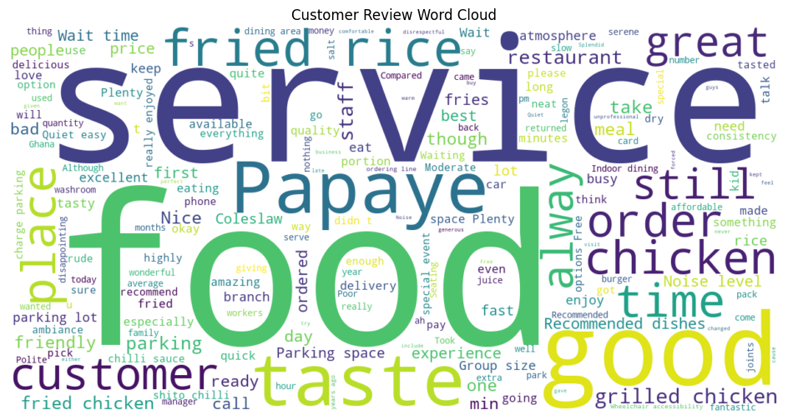
KEY CUSTOMER SATISFACTION DRIVERS Customer reviews revealed several recurring themes that drive customer satisfaction and strengthen overall brand perception.
Customer Strengths | Customer Feedback
🍗 Food Quality | Frequently praised across reviews
🍗 Fried & Grilled Chicken | Most commonly mentioned menu items
🏡 Family-Friendly Atmosphere | Comfortable dining environment
🚗 Parking Availability | Convenient and accessible parking
😊 Consistent Customer Experience | Positive experiences across visits
⭐ Brand Reputation | Customers frequently expressed trust, familiarity, and confidence in the brand
Key Insight
Food quality remains the strongest driver of customer satisfaction, with customers frequently praising the fried chicken, grilled chicken, and fried rice offerings.
The restaurant atmosphere, convenient parking facilities, and strong brand reputation also contribute positively to the overall customer experience.
Representative Customer Comments
“Papaye never disappoints.”
“Fast delivery, generous portions and tasty food.”
“Beautiful restaurant and family friendly.”
Business Implication
The findings suggest that food quality, customer experience, and brand reputation are important competitive strengths that should be maintained and consistently reinforced across all branches.

Slide 10
Key Customer Pain Points and Improvement Opportunities Customer reviews also highlighted recurring issues that negatively affected customer experiences and satisfaction levels.
Customer Concerns | Customer Feedback
⏱ Waiting Time | Long delays during peak periods
🐌 Slow Service | Delayed order processing and delivery
🍗 Product Availability | Frequent stock-outs of grilled chicken
🍽 Food Consistency | Variations in taste and food quality
🧂 Excessive Seasoning | Complaints regarding overly salty meals
Key Insight
Service-related issues emerged as the most frequently cited source of customer dissatisfaction. Long waiting times, slow service, and product availability challenges were recurring themes across negative customer reviews.
Representative Customer
• “I'm 5th in the queue but have been here for more than 20 minutes.”
• “Very slow service.”
• “They run out of grilled chicken options on most busy days.”
Business Implication
Addressing service delays, improving product availability, and enhancing operational consistency may significantly improve customer satisfaction and reduce negative customer sentiment.

Slide 11
Management Recommendations Based on the findings of this pilot study, the following recommendations may help enhance customer satisfaction and operational performance
Recommendation 1
Improve Service Speed During Peak Hours
Review staffing levels during high-traffic periods.
Reduce customer waiting times.
Improve order processing efficiency.
Recommendation 2
Strengthen Inventory Management
Improve forecasting for high-demand menu items.
Reduce stock-outs of grilled chicken and other popular products.
Recommendation 3
Standardize Food Preparation Processes
Reinforce operational standards across branches.
Ensure consistency in food quality and taste.
Recommendation 4
Continue Investing in Customer Experience
Maintain the family-friendly atmosphere.
Preserve cleanliness and dining comfort.
Continue leveraging customer service strengths.
Recommendation 5
Implement Ongoing Customer Review Monitoring
Track customer feedback regularly.
Identify emerging service issues early.
Support data-driven decision-making.
Consider expanding review analytics across all branches.
Business Value
Implementing these recommendations may improve customer satisfaction, strengthen brand perception, enhance operational efficiency, and support long-term customer loyalty across branches.

Slide 12
Conclusion
This pilot study analyzed 134 customer reviews from the Haatso and Tema branches of Papaye Fast Foods to better understand customer perceptions and identify opportunities for improvement.
The findings indicate that customer sentiment toward Papaye Fast Foods is generally positive, with food quality, atmosphere, and brand reputation emerging as key strengths.
At the same time, service speed, product availability, and operational consistency were identified as areas where improvements may further enhance customer satisfaction.
Overall, the study demonstrates how customer feedback analytics can provide valuable insights to support customer experience management and continuous improvement initiatives.

Slide 13
Thank You
Thank you for taking the time to review this analysis.
Prepared by: Richard Adutwum MSc Marketing Business Analytics & Customer Insights Professional

